Slide 1
How to Lock a Laser
Nolan McCleary
(With Pictures)

Slide 2
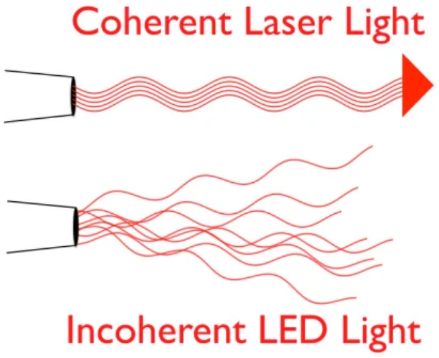
What is a Laser and Why is it Useful?
A perfect laser produces light waves that are all in phase with one another
This coherence can be exploited to do useful things
Interferometry, where relative phase differences between two beams encodes spatial distortions
Optical PSK, where the relative phase differences encodes a transmission symbol
Lithography applications where an extremely precise wavelength and high degree of coherence is required

Slide 3
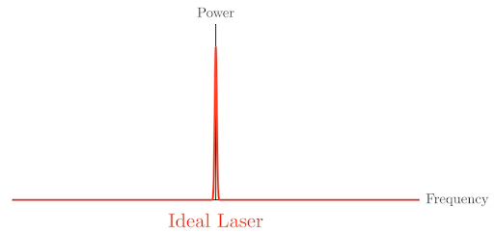
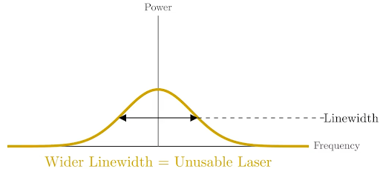
The Problem
Real lasers are not ideal
Both the laser’s phase and frequency are subject to random fluctuations
Expectation
Reality

Slide 4
The Solution
We don’t know how much each noise source contributes to our overall frequency noise
However, we do know that adjusting the current into the laser diode will let us adjust the beam’s wavelength/frequency
If we can measure frequency deviation at any given point in time, we can adjust the current to cancel it out i.e. we can keep the frequency fixed
Doing this will let us stabilize both the frequency and the phase of the laser since phase is just the accumulated history of frequency
Big Idea: Control current to control frequency, control frequency to control phase

Slide 5
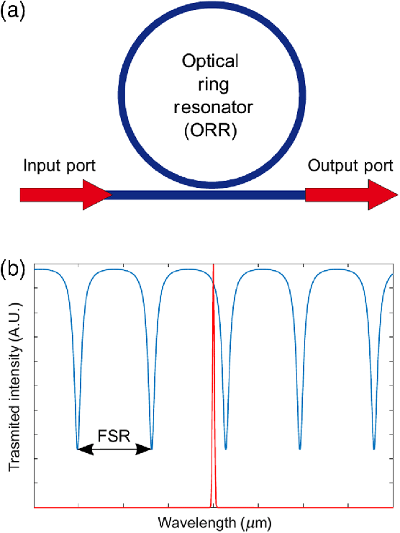
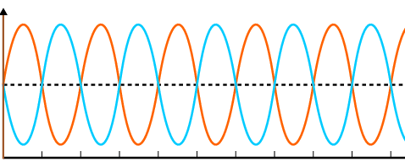
How Do We Measure This?
We can use some sort of frequency discriminator to give us a signal whenever the beam’s wavelength (and thus frequency) deviates from resonance
One way we can do this is with a ring resonator

Slide 6
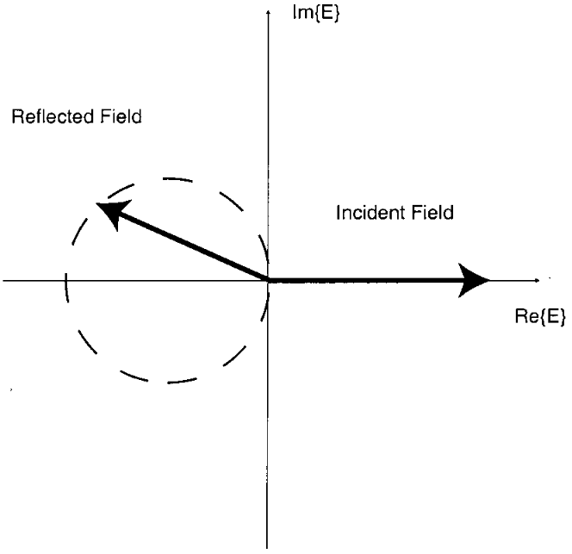
Complex Conjugate FD Response
FD creates a new field and adds it back to the input field
Resultant field can be modelled as a stretch/rotation of the input field
Resultant fields from detune in either direction are complex conjugates of one another

Slide 7
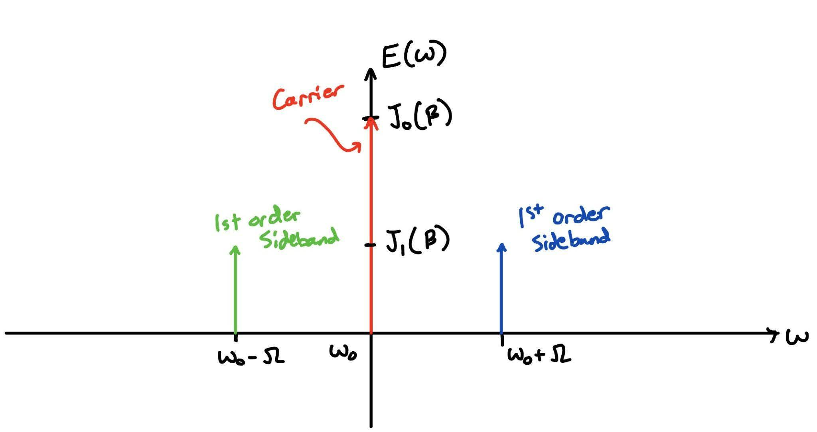

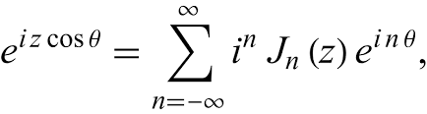
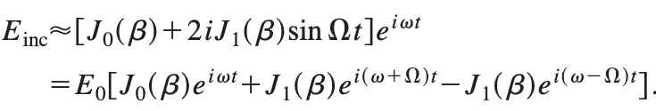
Bessel Expansion of a Modulated Sinusoid
If we modulate the phase of the input field, we can expand it with a Bessel Series
Cavity response now primarily composed of ~3 main fields when beta < 1
Carrier signal and two sidebands
Imaginary component of sideband response won’t change sign when detune direction reversed, carrier’s will

Slide 8
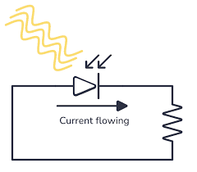
Series Discriminator Response and Power Output
Discriminator response is different between center frequency and sidebands
Center frequency response flips over imaginary axis if detune direction flips
Sideband response doesn’t do this
If we feed optical signal from a frequency discriminator to a photodiode, the resulting current is proportional to the optical power delivered
Mathematically this means we are multiplying the FD output by its complex conjugate

Slide 9
Getting Rid Of The Carrier
We have 3 main terms in our reflected signal, all are at a very high frequency
If we were somehow able to encode phase offset information in a beat signal, we could have it at a frequency instead of at carrier frequency
We can do this by getting the power of our optical signal
That’s exactly what a photodiode does!

Slide 10
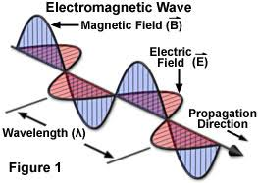
Getting Rid Of The Carrier
Power density of light wave is cross product of the magnetic field intensity vector with the electric field vector
Magnetic field intensity amplitude is equal to electric field amplitude divided by medium’s wave impedance constant
For our purposes, we disregard the constant
Since both fields are orthogonal, this means that power density is equal to electric field amplitude squared
P = |E|*|H| = |E|^2/Z
Our photodiode gives us a current proportional to this power signal

Slide 11
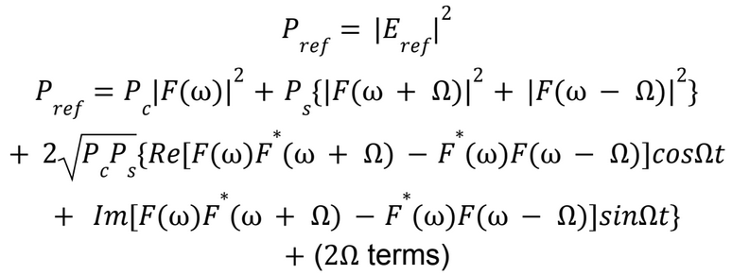
Getting Rid Of The Carrier
Photodiode current is proportional to our optical power, optical power is proportional to the length of our
Once we have the current, we can convert it to a voltage and feed it to our demod + control
Complex vector rotating at modulation frequency that flips by 180 degrees when detune direction changes

Slide 12
Getting Rid Of The Carrier
Mostly DC + Sinusoid at modulation freq
Sinusoid shifts phase by 180 when detune direction reverses
Ref = cos(omega * t)

Slide 13
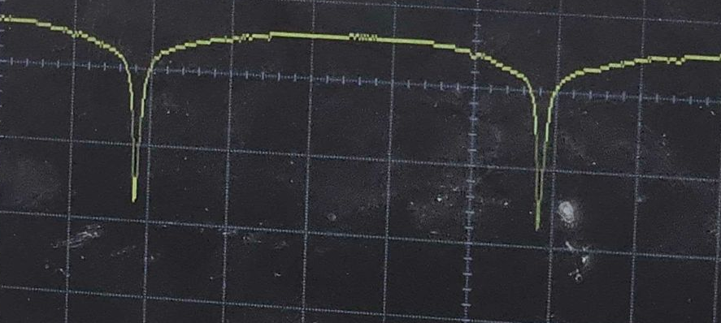
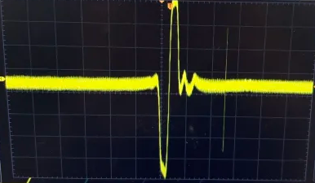
After Demodulating
Demodulate photodiode output to generate a new signal
New signal is odd-symmetric about resonance now
Since we now have magnitude and direction of the detuning, we can use it as an input signal to our controller
Positive detune
Resonance
Negative detune

Slide 14
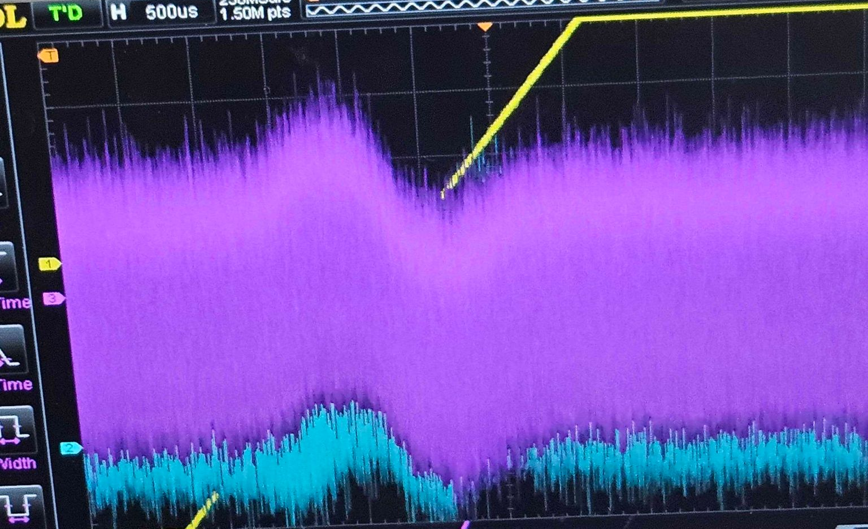
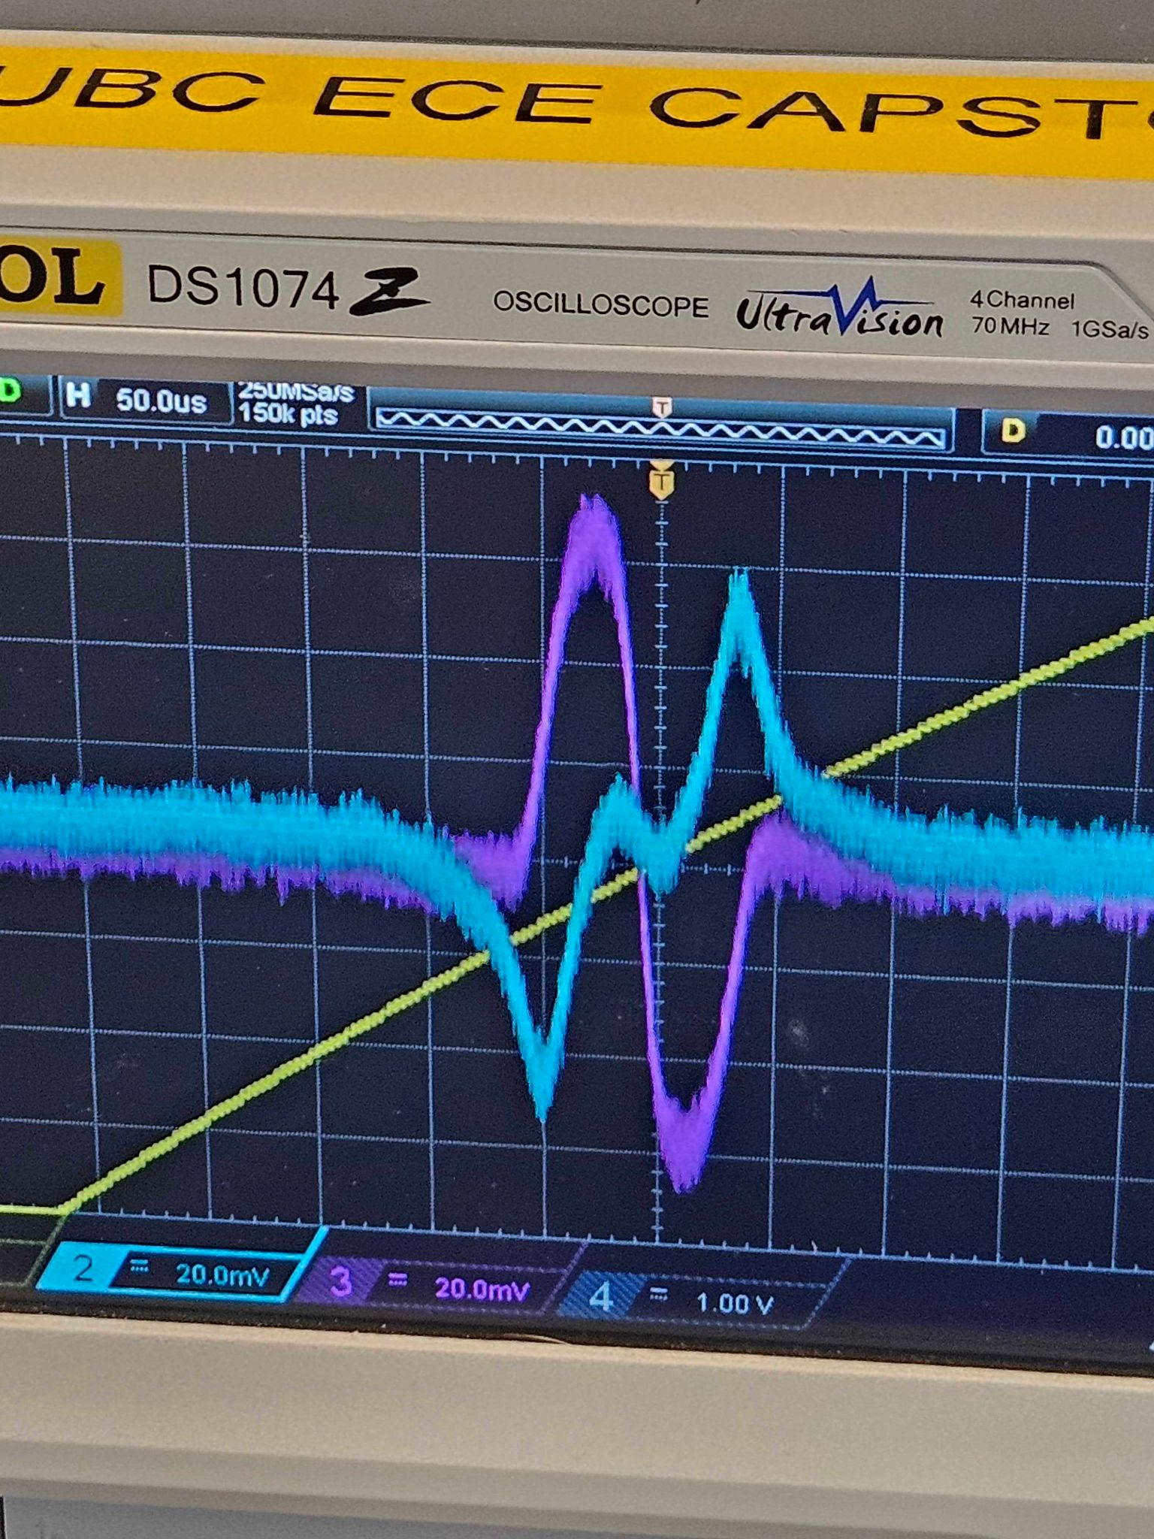
Issue: Optical Gain
How much optical power we expect to recover per unit detune dictates SNR of signal fed to controller
Some noise we can’t eliminate, but we can make it a proportionately smaller part of our input signal

Slide 15
How do we Maximize Optical Gain?
Big Idea: The SNR of the error signal we feed to our controller determines the controller’s performance ceiling

Slide 16
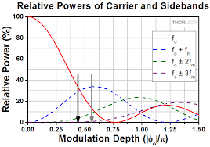
Optimizing Modulation Depth
Modulation depth (beta) is determined by the voltage ratio of EOM driver amplitude relative to voltage required to induce 180 degree phase shift in EOM
Determines power distribution over Bessel modes
Want to concentrate power in 0th and first-order modes

Slide 17
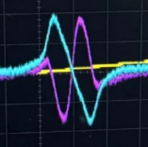
Optimizing Demod Phase
Relative phase between reference signal and input dictates both the sign and magnitude of the demodulated output.
Phase difference of over 90 degrees will flip sign
Phase difference near 90 degrees will result in very low gain
We can get around this by demodulating over two axes 90 degrees apart (IQ Demodulation), then ‘align’ the signal.
Take both signals and feed to a rotation matrix with calculated adjustment angle set
Phase-shift the demod signal directly

Slide 18
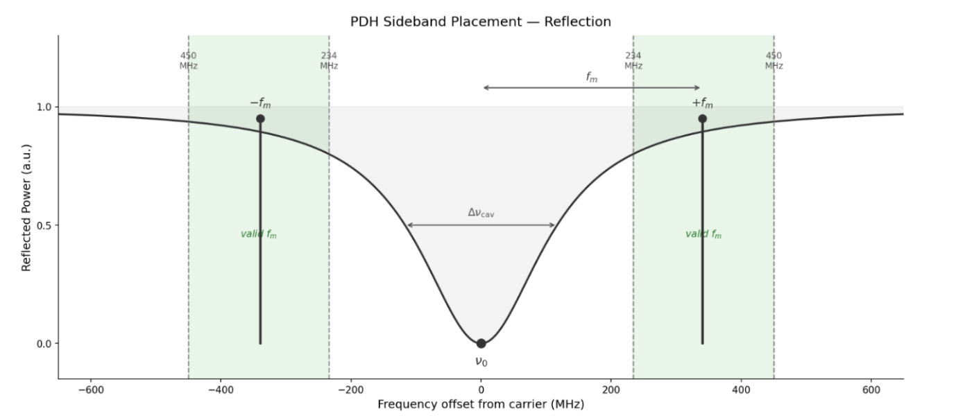
Using a Higher Modulation Frequency
If the cavity response isn’t very ‘sharp’ (low finesse), then the sidebands might still get attenuated
To compensate with this, we can modulate/demodulate at a higher frequency
For example, keep control circuitry digital but implement the mod/demod over analog

Slide 19
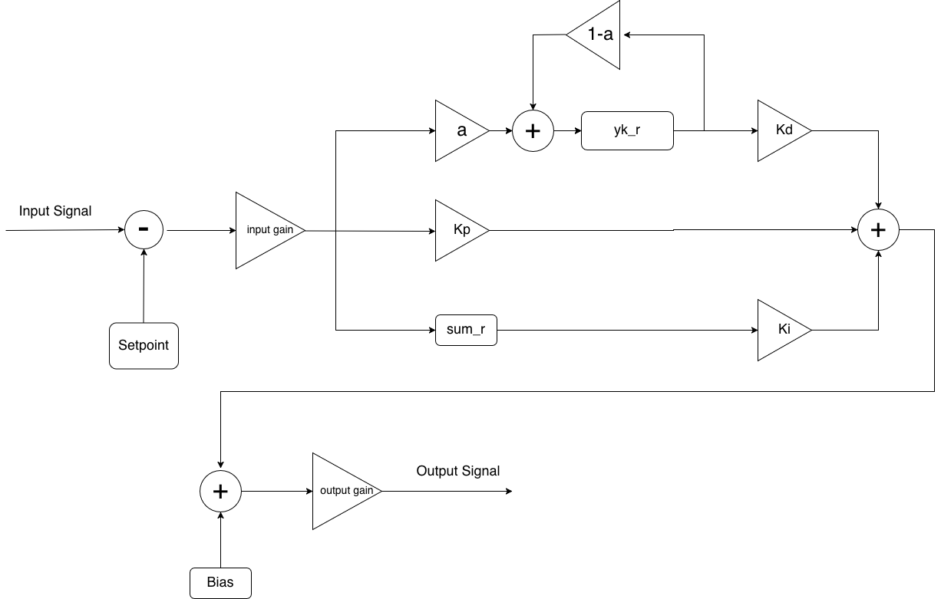
Introducing The Controller

Slide 20
Issue: Ensuring Controller Stability
Controllers can become unstable when feedback from previous actions arrives too late to be properly accounted for in the controller’s current action.
The easiest fix is lowering the rate at which the controller applies its signal
But if we lower it too much, then we lose the ability to correct high-frequency noise and may actually make it worse!
We need a way to determine the highest speed we can run the controller at safely

Slide 21
Solution: Calculate Loop Delay
1) Send pulse down the loop, start timer and set trigger
2) Stop timer when trigger detects pulse on other end
Good heuristic is fmax ~= 1/Tloop

Slide 22

Assessing Controller Performance
Measure the RMS error signal fed to the controller as input.
Good controller should reduce this value.
This should work, right?

Slide 23
No.

Slide 24
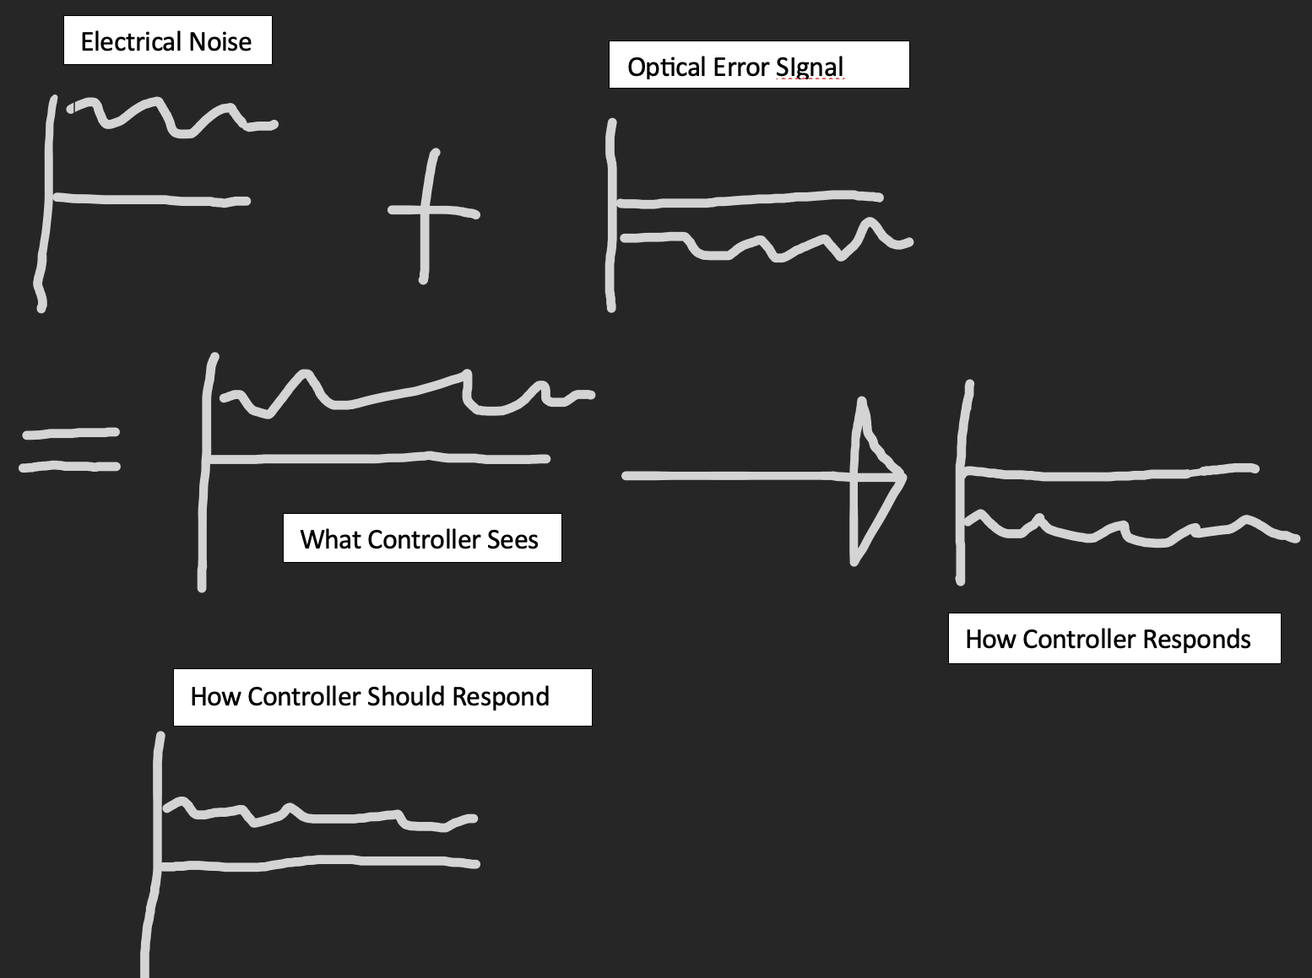
Issue: Optical Error vs Electrical Noise
The optical signal passes through electrical circuitry before the controller receives it
This electrical circuitry adds noise that we don’t want our controller to react to
If we aren’t careful, the controller may also respond to electrical noise

Slide 25
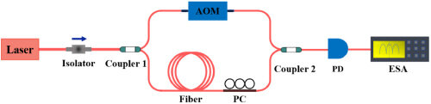
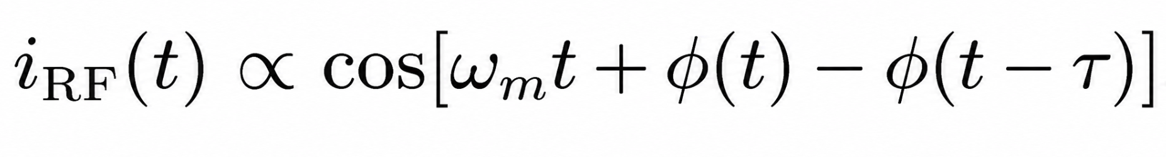
Solution: Delayed Self-Heterodyne
Split beam
Increase optical frequency on one arm via AOM
Delay on the other via fiber delay
Recombine both signals and get power via Photodiode
New signal is a sinusoid at AOM modulation frequency, demodulate it then get PSD to approximate laser noise PSD.

Slide 26
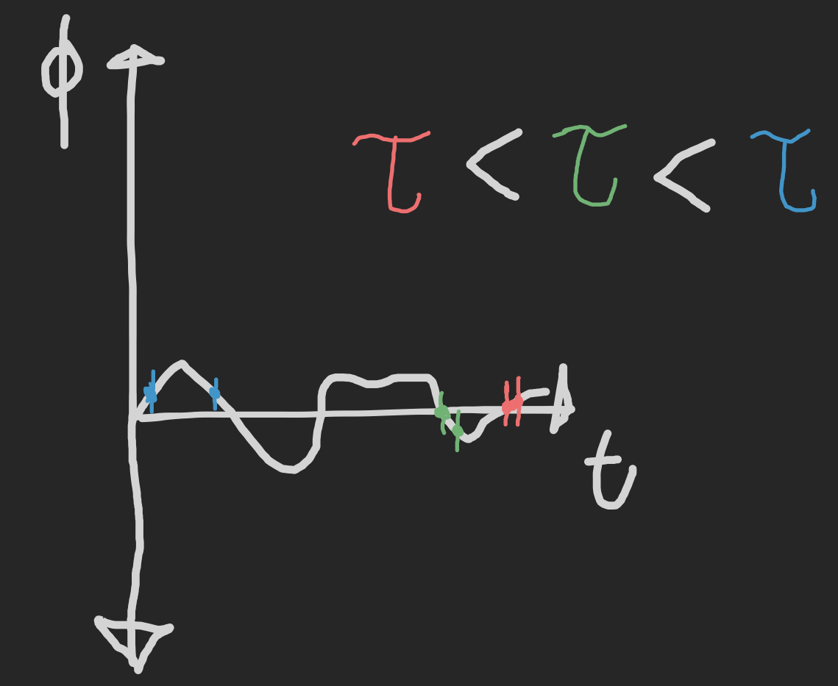
Issue: How do we Pick a Delay?
Delay too long: Will not be able to see phase changes that happen very quickly
Delay too short: Not enough difference between the two phase values, SNR degrades

Slide 27
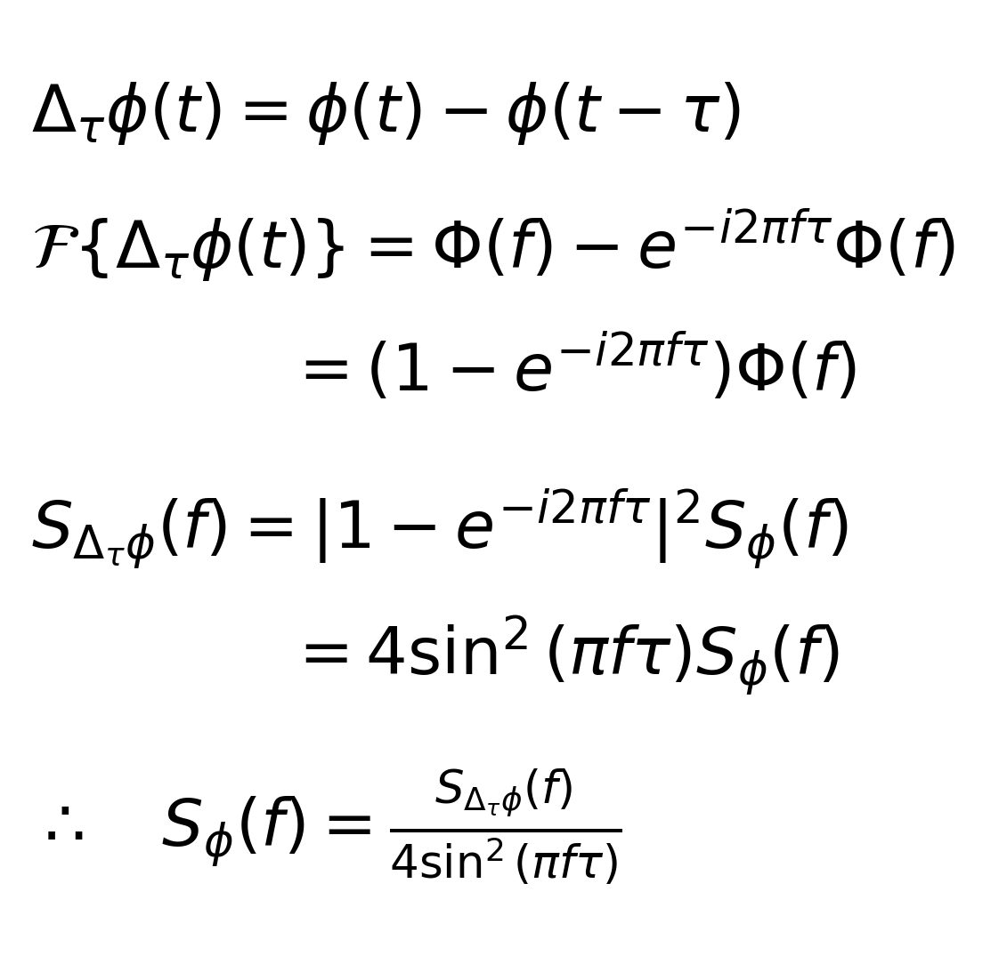
Phase Noise PSD
Phase difference PSD by itself still not super useful, need to convert to phase noise PSD
Tau delay is phase shift in freq domain
Find transfer function relating phase difference noise to phase noise

Slide 28
How Do We Tune Our Controller?
We now have the phase noise PSD and can use it as an objective for tuning our controller
But how do we go about actually tuning it? (setting Ki, Kp, Kd etc)

Slide 29
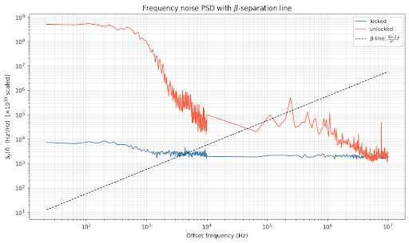
Tuning the Controller
Can use band-limited root-mean-square of the phase noise PSD as a metric
Get baseline RMS value with controller disengaged
Zero Ki, Kd, Kp
Increase Kp until we start to see new oscillation spike on phase noise PSD
Reduce Kp until spike gone, inc Kd while doing so reduces RMS MZI output PSD
Increase Ki while doing so reduces RMS MZI output PSD

Slide 30
Filtering Electrical Noise
Sometimes electrical noise is just there and there’s nothing we can do about it
We need to filter it out

Slide 31
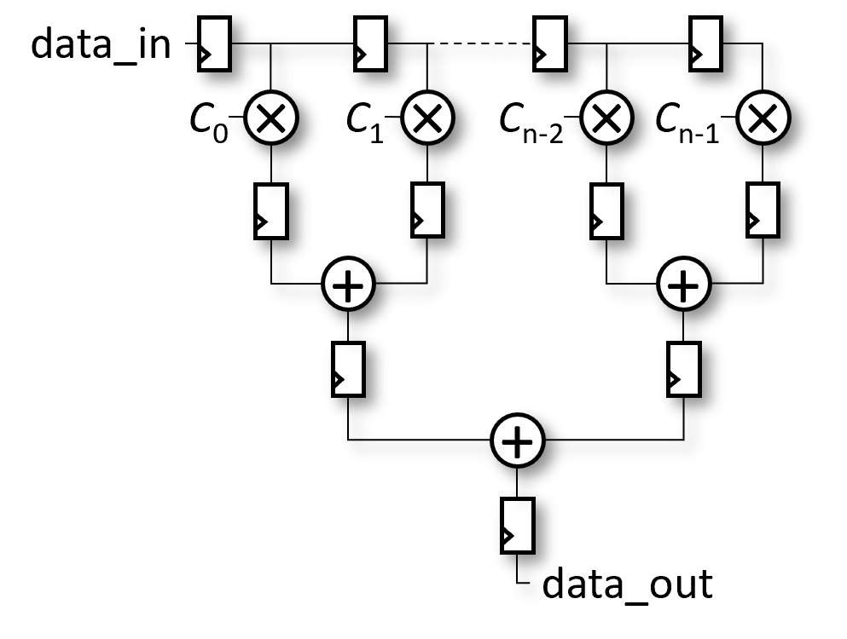
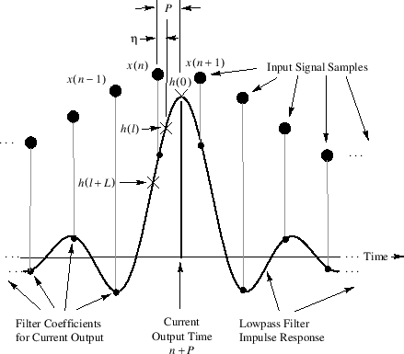
Solution: FIR Filter

Slide 32
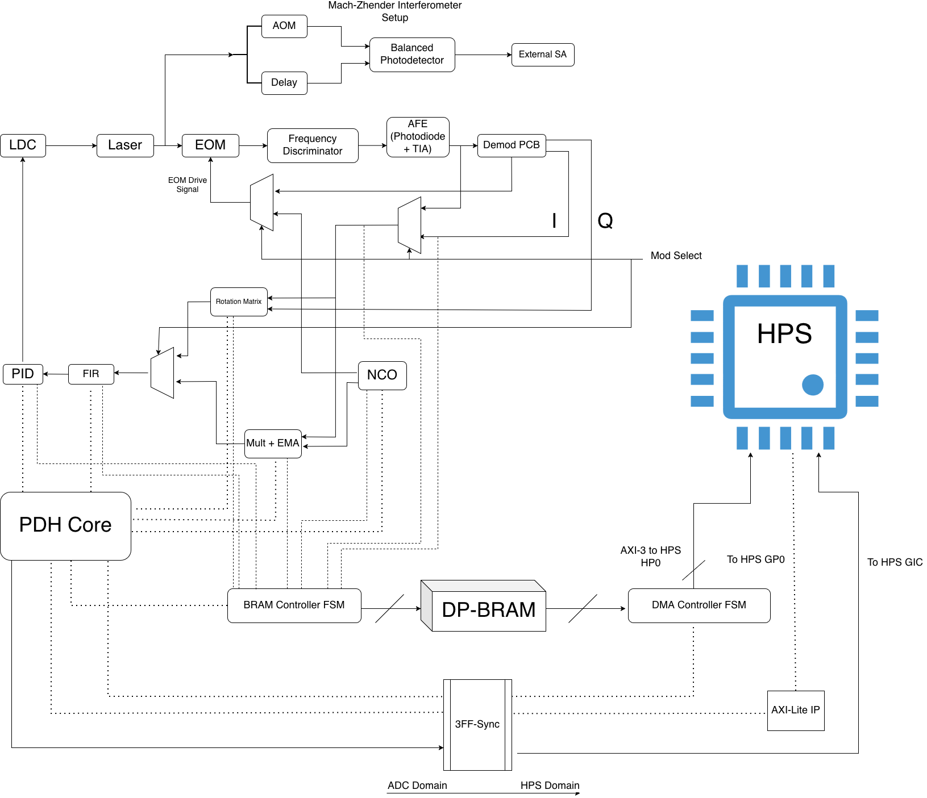
Implementation
Run control/digital filtering on FPGA fabric
Mod/demod either on fabric or standalone PCB
HPS allows the whole system to be software-defined

Slide 33
HPS Interfacing
Control plane
Lets processor configure FPGA circuitry as needed
Latency concern is minimal
Data plane
FPGA can dump its signals into a BRAM block and feed that data to processor’s DMA controller over an AXI3 interface
Lets processor get large amounts of real-time data off the FPGA quickly without impeding the fabric’s operation
Useful for things like tapping controller/filter signals, viewing PSD’s etc
GIC interface
Fabric can assert interrupt signal to GIC’s IRQ vector
Processor can respond to interrupt as needed based on the context

Slide 34
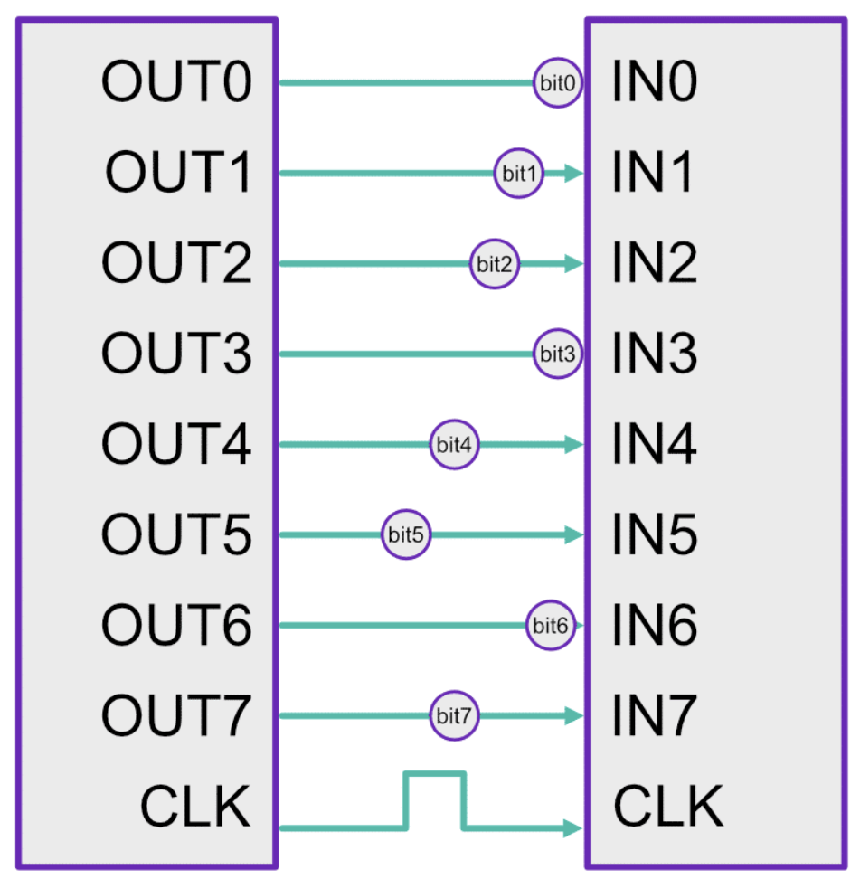
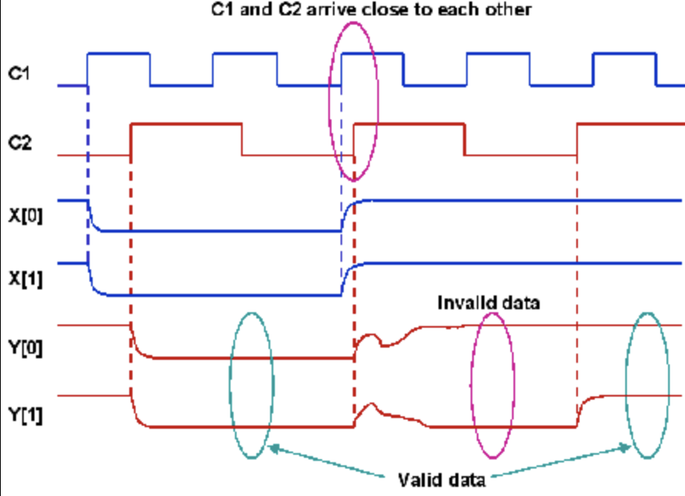
Issue: Clock Skew and Metastability
Metastability happens when the (changing) signal going into a flip-flop has not been asserted long enough before the clock edge or is not held long enough after the clock edge
Clock skew happens when the data going into a system doesn’t arrive at the same time as what that system is clocked on
Could be metastable
Could assume old data is still valid

Slide 35
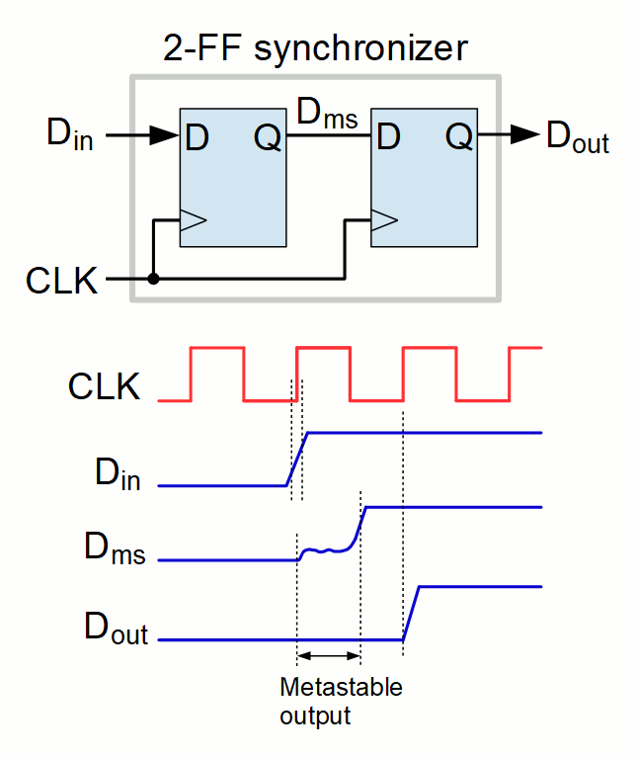
Solution Primitive: Flip-Flop Sync
The flip-flops want to be stable, they just need time :)
First flip-flop will take brunt of metastable signal, but it has a whole clock cycle to resolve cleanly
Second flip flop will have exponentially lower chance of also receiving a metastable input
Need lower probability of metastability? Add more flip flops!

Slide 36
Control Plane Solution: Strobe Protocol
FF-Sync can lower probability of metastable output to ~0
Doesn’t guarantee that that output value matched what the input was supposed to be if the input is metastable
For 1-bit signals this means the signal will get delayed by a clock cycle
For multi-bit signals, this means that the signal might be torn (like with clock skew)
Solution: send out our data bits first, then send a strobe bit to mark them as valid
If strobe 0-1 transition catches an edge and gets delayed by one cycle, whatever
Guarantees that data bits have stabilized
Can send callback signal to processor when input is received
Emit GIC IRQ to notify processor that callback has been sent
Processor can service callback either in the IRQ handler directly or use IRQ as a threading signal (UIO handler) etc

Slide 37
Data Plane Solution: Dual-Port BRAM
Clock BRAM input on ADC clock domain, clock output on processor domain
Write to / Write from BRAM via FSM
Start-finish protocol on each FSM
Start and finish signals 3ff synchronized between fabric core and AXI DMA module feeding to processor’s DMA controller
Much faster/simpler than async FIFO
Easier to debug
Can run at max clock rate without overflow, will never jam
We have enough BRAM for it… or do we?

Slide 38
Issue: NCO BRAM Consumption
Two main ways to generate a sine wave digitally
LUT: Have table of sin coefficients and iterate through it
CORDIC: Algorithm that calculates coeff with progressively more accuracy, requires multiple clock cycles
CORDIC will decimate our top-end rate, bad if our cavity finesse is low
Need LUT
Still want high accuracy at lower freqs and low jitter at high freqs so the table may need to be large
FULL-size high-resolution LUT can take up a LOT of BRAM
~4096 16-bit coeffs

Slide 39
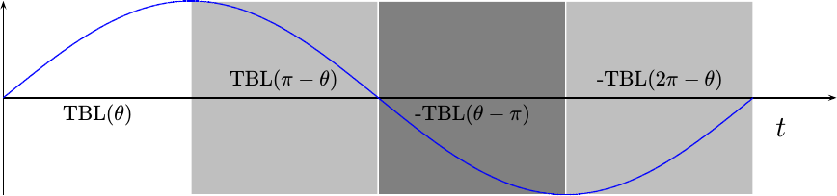
Solution: Quarter-Wave Table
We can just keep a quarter of the sine wave period in memory and flip traversal order/sign as needed as we advance
Cuts down our memory footprint by a factor of 4!

Slide 40
What We Covered
Why eliminating laser noise is useful
Basic principles behind the Pound-Drever-Hall method
Practical controller implementation with considerations for the optical environment
Hardware-software system integration for better system reconfigurability/ergonomics
Implementation considerations

Slide 41
Questions?

